Slide 1

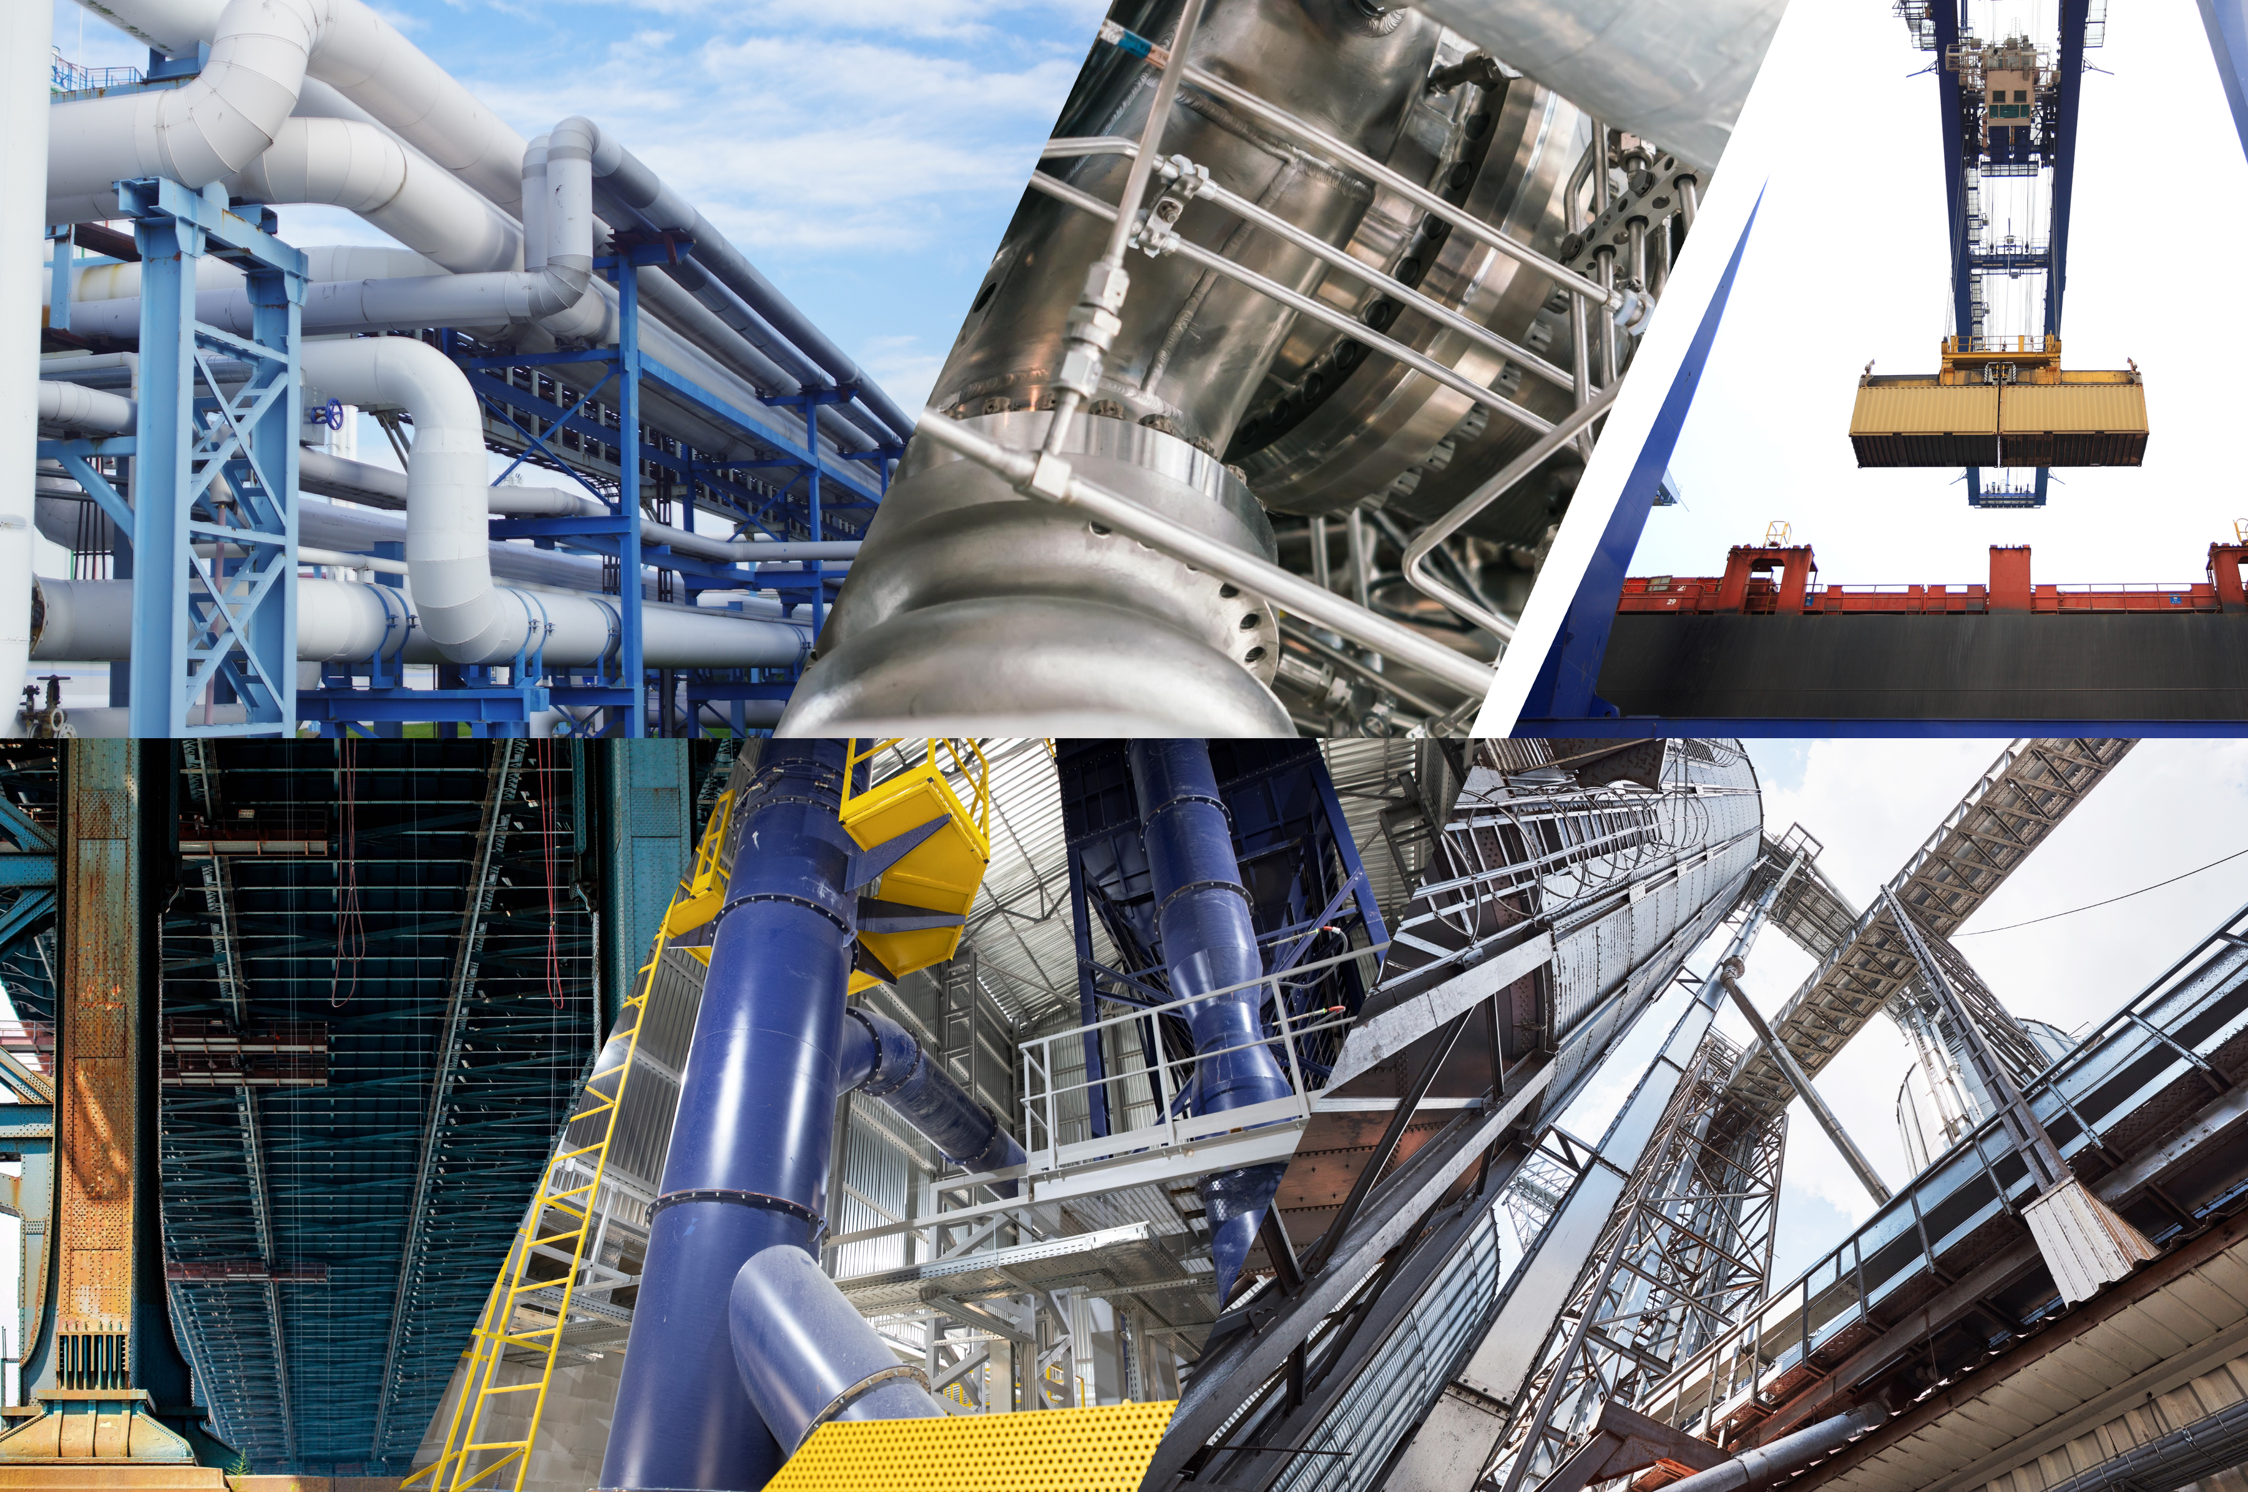
Thermolysis Co., Ltd.
CarbDurax™ Carbon Fiber Proactive Wear-Resistant Coating Series
Product Specifications
Revision Date：2025/11/28
THERMOLYSIS Co., Ltd.

Slide 2
CarbDurax™ Carbon Fiber Proactive Wear-Resistant Coating Series
【Ⅰ. Basic Information】
CarbDurax™ Carbon Fiber Proactive Wear-Resistant Coating Series
⬧ Product Name：
⬧ Product Model：
This product is available in four models, classified by the particle size of the handled material and the application surface—flat, vertical, or sloped—to provide more accurate usage options.。
⬧ Packaging：This product is offered in both large and small packages, each with two containers: Component A (epoxy resin) and Component B (hardener). Mix them according to the specified ratio before use.
  ⬧ Recommended Usage：About 15.5 kg is needed for 1 m² at 1 cm thickness. Actual usage may vary based on substrate conditions.
  ⬧ Brand：THERMOLYSIS
⬧ Manufacturer：Thermolysis Co., Ltd.
⬧ Product Category：Building Materials – Wear-Resistant Coating Series
Category | For Flat Surfaces | For Non-Flat or Vertical Surfaces
Coarse Particles (2–3 mm) | CarbDurax™ F-FLOW G | CarbDurax™ V-FLEX G
Fine Particles (1–1.5 mm) | CarbDurax™ F-FLOW M | CarbDurax™ V-FLEX M
【Ⅱ. Product Features】
The CarbDurax™ Series is a dual-component coating system designed for heavy-wear industrial environments. Formulated with epoxy resin, chopped carbon fiber, and zirconia, it delivers outstanding abrasion resistance and enhanced mechanical strength, providing dual protection against wear and corrosion. Primarily intended as a preventive coating, it is recommended for application during new equipment installation or major overhauls to extend service life, reduce wear, and lower maintenance frequency. Suitable for steelmaking, metal processing, cement, mining, petrochemical, port, and shipbuilding industries, CarbDurax™ offers a reliable protection solution that extends equipment lifespan, reduces downtime, lowers maintenance costs, and supports long-term sustainable operations.
THERMOLYSIS｜
01

Slide 3
CarbDurax™ Carbon Fiber Proactive Wear-Resistant Coating Series
【 Ⅲ. Product Description】
Item | Method / Condition | Description
Chemical Base Type | Epoxy Resin
Appearance (Resin) | Light Gray Paste
Appearance (Hardener) | Dark Gray Paste
Appearance (After Mixing) | Dark Gray Paste
Mixing Ratio (Component A : Component B) | CarbDurax™ F-FLOW Series4.5 : 1 (by weight)
 | CarbDurax™ V-FLEX Series4 : 1 (by weight)
Curing Method | Ambient Temperature Curing After Mixing
Application | Coating
Service Temperature | -20°C to 130°C
Working Time | 23℃ | 30 min | 30 min
Initial Curing Time | 23℃ | 2 hr. | 2 hr.
Full Curing Time | 23℃ | 8 hr. | 8 hr.
Product Density | ASTM-D792 （23℃/23℃） | 1.55 | 1.55
Lap Shear Strength | ASTM-D1002 （23℃） | 18 MPa | 18 MPa
Shore Hardness, Hardness D | ASTM-D638 （23℃） | 80 | 80
Abrasion Resistance | STM G 75-01，2hr | 質量損失1% | 1% mass loss
 | STM G 75-01，4hr | 質量損失1% | 1% mass loss
 | STM G 75-01，6hr | 質量損失2% | 2% mass loss
Impact Test | ASTM D256 | 24 J/m | 24 J/m
THERMOLYSIS｜
02

Slide 4
CarbDurax™ Carbon Fiber Proactive Wear-Resistant Coating Series
【Ⅳ. User Guide】
Surface Preparation
  Proper surface preparation is essential for long-term performance. Requirements may vary with the environment, service life, and substrate condition. Select the preparation method that best fits the site conditions.
  For metal surfaces to be pre-coated, proper cleaning is required. A sandblasting grade of 2.5 is recommended to remove residual dirt, oil, grease, and other contaminants from the metal surface.
  Metal surfaces exposed to salt solutions (e.g., seawater) should be sandblasted or high-pressure water blasted, then left for 24 hours to allow salts to rise to the surface. Repeat as needed until the chloride level is below 30 mg/m³ (3 μg/cm³). After reaching this level, perform the final sandblasting before coating.
  For best performance, installing a metal mesh reinforcement over the application area is recommended.
Mixing
  For CarbDurax™ F-FLOW, mix Component A (resin) and Component B (hardener) at a weight ratio of 4.5 : 1.
  For CarbDurax™ V-FLEX, mix Component A (resin) and Component B (hardener) at a weight ratio of 4 : 1.
  Weigh according to the required ratio or mix the full contents on a clean, dry mixing board. Blend until the color becomes uniform.
  If the resin and hardener are stored at 10–20°C or lower, preheat the resin to approximately 25–30°C, but do not exceed 40°C.
Application
  Apply the fully mixed material onto the prepared surface.
  At 25°C, the working time is about 20 minutes, and initial curing takes around 2 hours. Both times change with temperature and thickness—higher temperatures cure faster. Apply at a recommended thickness of 5–8 mm; thicker layers will extend curing time.
  For a smoother finish, you may place a plastic film over the coating and press it evenly.
Inspection
  After application, visually inspect the surface to ensure there are no pinholes or voids.
  After the coating has cured, repeat the visual inspection to ensure there are no voids or damaged areas.
THERMOLYSIS｜
03

Slide 5
CarbDurax™ Carbon Fiber Proactive Wear-Resistant Coating Series
【Ⅴ. Precautions】
Sedimentation in Component A is normal; stir thoroughly before use.。
This product is not recommended for repairing sites with liquid leakage.
This product is not recommended for use in environments with high oxygen concentration.
Avoid applying the product during rainy weather or under high humidity conditions (over 70% RH).
【 Ⅵ. Packaging and Storage Requirements】
Both standard packaging options of this product (large and small) include a two-component system consisting of Component A (resin) and Component B (hardener). Use the material as soon as possible after opening, and ensure any remaining portion is tightly sealed to prevent moisture absorption or deterioration.
Store the product in a dry area free of corrosive gases. Under the recommended conditions (temperature below 35°C and humidity below 50% RH), the shelf life is 6 months. Refrigeration or freezing is not required.
【Ⅶ. Disclaimer】
The information in this document, including product usage and application recommendations, is based on our current knowledge and experience. However, actual conditions vary by user, environment, and process, and are beyond our control. Therefore, we cannot guarantee product performance for any specific use or expected outcome. We strongly recommend conducting your own tests and verification before application to ensure the product meets your specific requirements and conditions.
Headquarters
Rm. 1, 3 F., No. 306, Sec. 1, Wenxin Rd., Nantun Dist., Taichung City 408368, Taiwan(R.O.C.)
TEL: +886 4 2698 0329
FAX: +886 4 2698 0330
Factory
No. 3, Yonggong 9th Rd., Yong'an Dist., Kaohsiung City 828106, Taiwan(R.O.C.)
https://www.thermolysis-asia.com
info@thermolysis-asia.com
THERMOLYSIS｜
04

