Slide 1

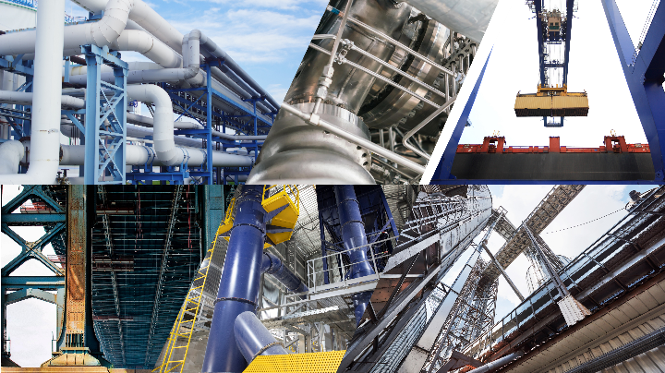

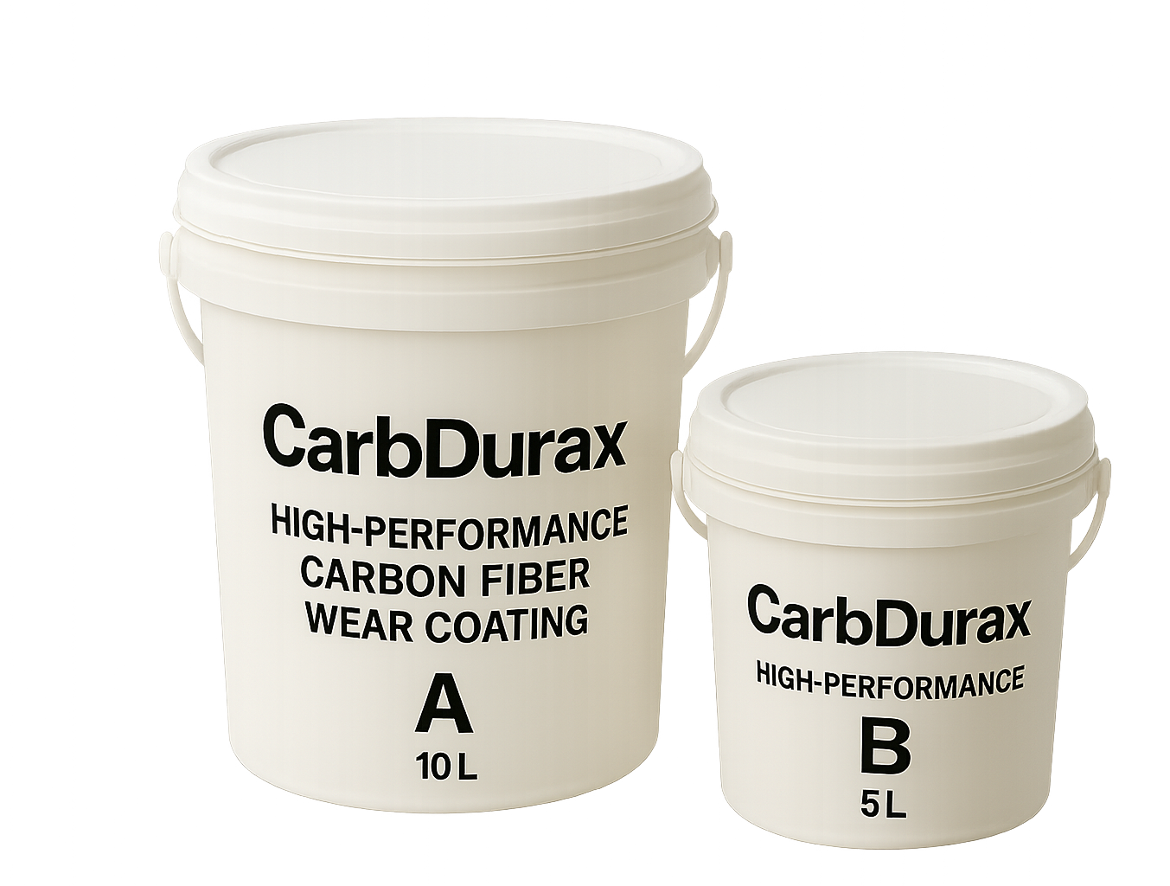
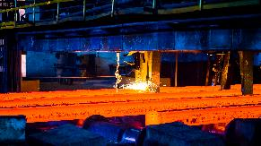
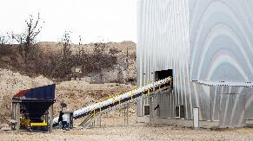

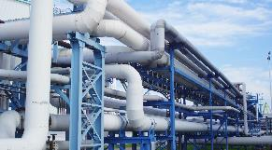
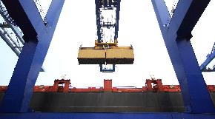
CarbDurax™ Carbon Fiber Proactive Wear-Resistant Coating Series
Wear-Resistant Material Built for High-Strength Industrial Environments
Enhanced with Carbon Fiber for Superior Abrasion Resistance
A Revolutionary Wear-Resistant Coating That Protects Your Critical Equipment
A Preventive Coating Applied During New Equipment Installation or Major Overhaul
Solving the Challenges Your Equipment Faces
In steel and mining operations, particle impact can cause corner damage, outlet chipping, and pipe-wall perforation.
In metal and cement processing, fine-powder friction and thermal expansion can lead to wall thinning, delamination, and abrasion.
In petrochemical systems, high-speed gas–solid flow can cause severe elbow wear and require frequent repairs.
In port handling and shipbuilding, material impact, metal scraping, and salt exposure can result in surface cracking and corrosion.
安能聚綠能股份有限公司

Slide 2
【Product Information】
Product Name：CarbDurax™ Carbon Fiber Proactive Wear-Resistant Coating Series
Brand：THERMOLYSIS
Manufacturer： THERMOLYSIS CO., Ltd.
Packaging：This product is offered in both large and small packages, each with two containers: Component A (epoxy resin) and Component B (hardener). Mix them according to the specified ratio before use.
Product Model：Choose the appropriate type based on the material’s particle size and whether the application surface is flat, uneven, or vertical.
Category | For Flat Surfaces | For Non-Flat or Vertical Surfaces
Coarse Particles (2–3 mm) | CarbDurax™ F-FLOW G | CarbDurax™ V-FLEX G
Fine Particles (1–1.5 mm) | CarbDurax™ F-FLOW M | CarbDurax™ V-FLEX M
Recommended Usage：About 15.5 kg is needed for 1 m² at 1 cm thickness. Actual usage may vary based on substrate conditions.
Storage：Store in a dry place away from corrosive gases. Shelf life: 6 months. No refrigeration needed.
【Product Features】
Carbon Fiber Reinforced Design
Unmatched Wear Resistance
Carbon fiber boosts impact resistance and strength for longer-lasting protection.
Provides superior protection against abrasion from solid materials and fine powders.
Multiple Options
Reduce Costs and Downtime
F-FLOW provides high fluidity for flat surfaces, while V-FLEX works on vertical or curved areas without sagging.
Preventive coating on high-wear areas extends pipe life and reduces unexpected repair costs and production interruptions.
Proven Performance
Suitable for Multiple Industries
Adopted by major steel manufacturers for slag and sinter transport lines, demonstrating excellent wear protection.
Works in solid-material transport across steel, cement, mining, petrochemical, port, and shipbuilding sectors.
THERMOLYSIS｜

Slide 3

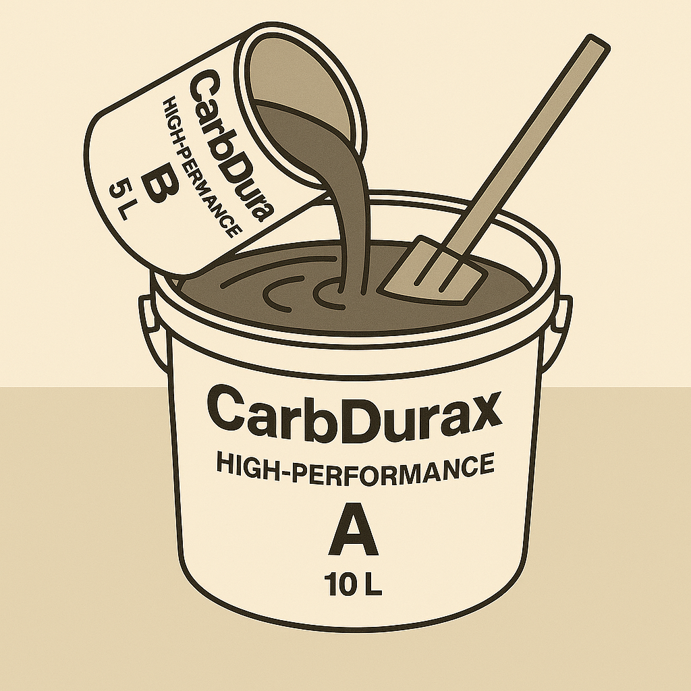
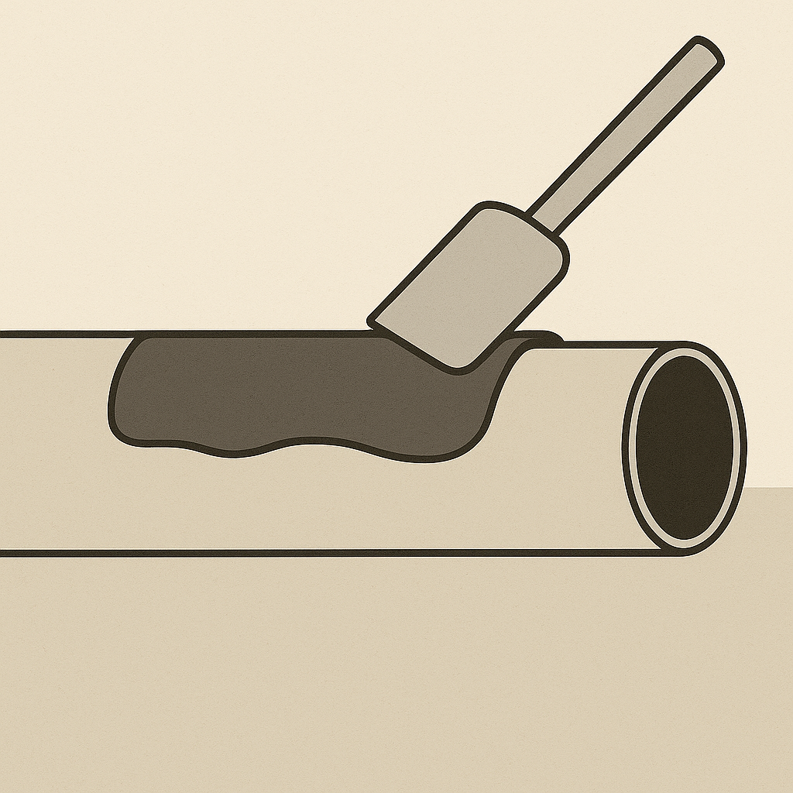
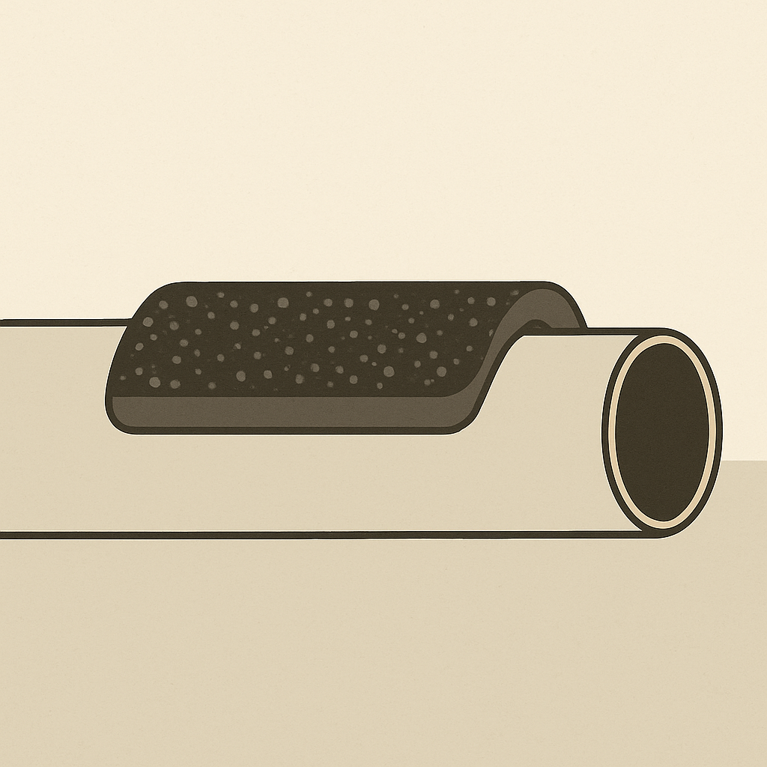

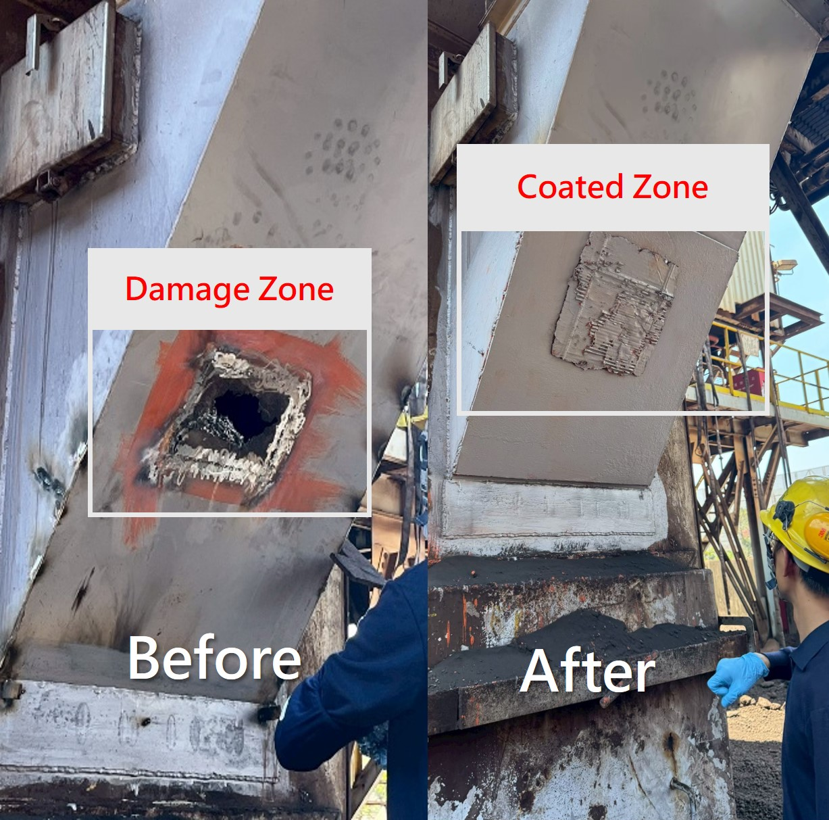
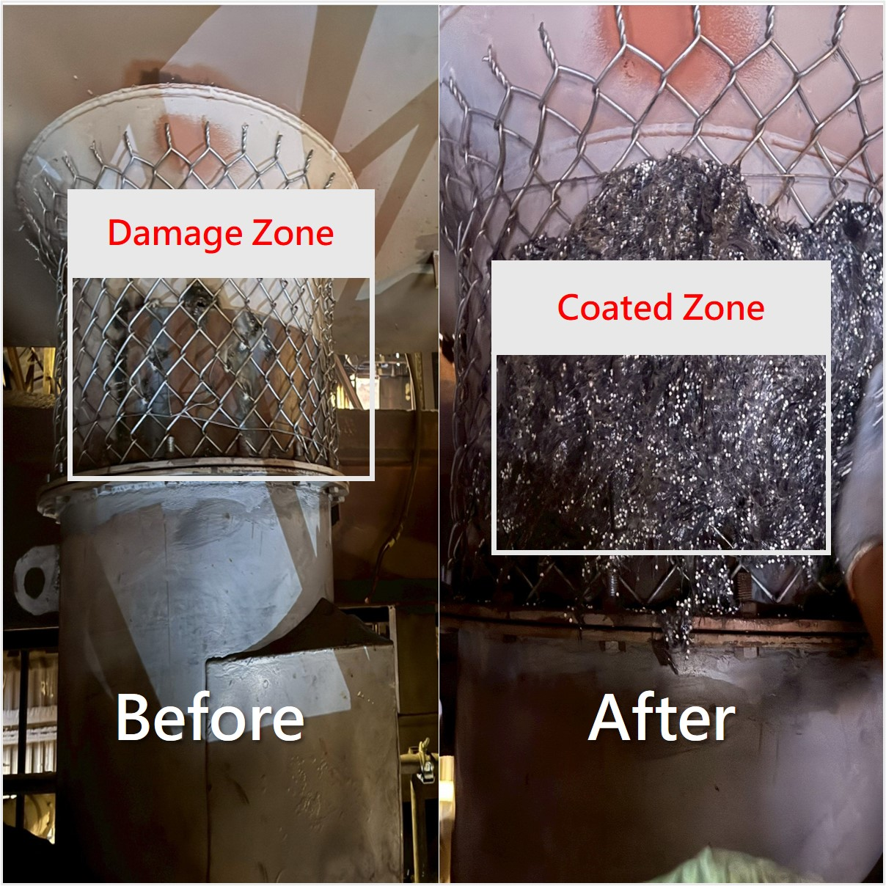
【Application Procedure】
01. Surface Preparation
02. Mixing
01
Clean the target equipment or pipeline surface by removing oil, rust, dust, and any loose materials.
02
Add Component B into Component A and mix thoroughly until the carbon fibers are uniformly dispersed throughout the resin, ensuring optimal performance.
03. Coating Application
04. Curing
03
Apply the mixed compound evenly onto the prepared surface, pressing firmly to eliminate air pockets and ensure maximum protective effectiveness.
04
Initial curing is achieved in approximately 6 hours (non-sag stage), with full curing completed within 24 hours, forming a strong and highly wear-resistant protective layer.
Notes：
This product is intended as a preventive coating and is best applied during new installation or major maintenance to extend equipment life and reduce wear. For damage repair, it should only be used for small emergency patches, and performance will vary with site conditions.
Ensure good ventilation during application and avoid high-humidity or low-temperature conditions (recommended: 15–35°C, humidity below 85%).
Seal unused material and keep it away from moisture and direct sunlight.
Sedimentation in Component A is normal; stir thoroughly before use.
This is an industrial coating. Wear gloves, safety goggles, and a mask during application.
【Field Applications】
Slag Vertical Chute at a Steel Plant
Vertical Sinter Ore Pipeline at a Domestic Steel Plant
THERMOLYSIS｜

Slide 4
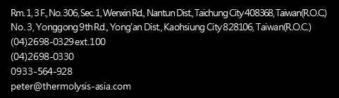

Headquarters
Rm. 1, 3 F., No. 306, Sec. 1, Wenxin Rd., Nantun Dist., Taichung City 408368, Taiwan(R.O.C.)
TEL: +886 4 2698 0329
FAX: +886 4 2698 0330
Factory
No. 3, Yonggong 9th Rd., Yong'an Dist., Kaohsiung City 828106, Taiwan(R.O.C.)
https://www.thermolysis-asia.com
info@thermolysis-asia.com

